Slide 1
Test Strategy for
New Components with Release 2
Submitted By:
Testing Squads Team
Nagarro Autothon

Slide 2
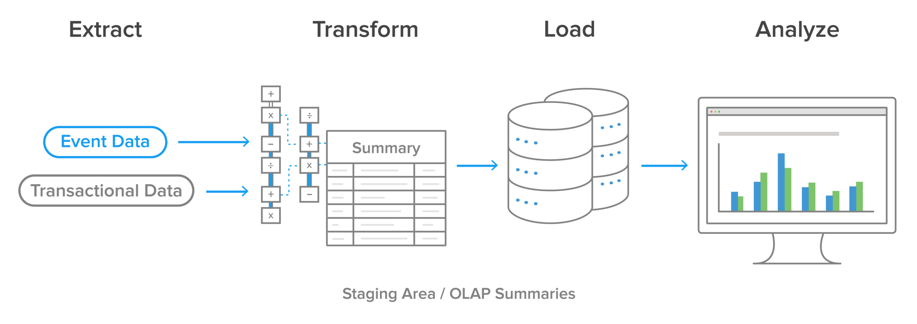
End-to-End Data Warehouse Testing Strategy
Data is extracted from the source, transformed to match the target schema, and loaded into the data warehouse. ETL testing ensures that the transformation of data from source to warehouse is accurate. It also involves verifying data at each point between the source and destination. D
For Automated ETL Testing, we can use any commercial tools/opensource tools available in the market
- Query Surge, Informatica Data Validation, QualiDI..etc.
Areas to be covered in test scope :
Finding bad and non-compliant data
Data integration testing
Testing across platforms
Managing test cycles through dashboards and reports
Meaningful auto test data generation using constraints and referential integrity
Automated test case generation for direct mappings
Central test case repository allows test schedules for regression testing
Test execution maintained in batches for regression and retesting
Test execution results in dashboards and reports available at a click
Built-in defect tracking and monitoring, interfacing with a third-party defect tracking tool

Slide 3
Data Streaming Testing
Performance Testing Streaming Data and Applications
Streaming data testing measures TCP socket-to-socket connections for jitter — one of the key areas affecting real-time streaming data flow. Other tests performed during streaming data testing for video, audio, and other forms include:
Network connection tests, The data stream is also analyzed for multimedia performance
Measurement of jitter and packet losses.
Bandwidth Consumption of application
For Performance and Load Testing we can use Jmeter.
It’s a open source tools and is best for application performance tests

Slide 4
Payment Gateway Testing
Payment Gateway testing is testing of a Payment Gateway. A payment gateway system is an e-commerce application service that approves credit card payment for online purchases. Payment gateways safeguard the credit card details by encrypting sensitive information like credit card numbers, account holder details and so on.
Kinds of Testing required
Functional Testing – Functional testing is required for newer, less established payment gateways to ensure that the application behaves as it should i.e. it handles orders, calculations, taxes, etc. exactly how it is supposed to. For more established payment processors, this kind of testing may not be required.
Integration Testing – Integration testing is critical while integrating with a payment gateway. As a tester, you would need to verify that the integration of your website/online store/application is working fine with the chosen payment gateways. As a tester you need to verify the entire transaction flow: Place order → Check if funds are received in merchant account→ Verify if transaction can be refunded or void successfully
Performance Testing – It is essential to test the website/online store/application for performance. The payment processor should not fail if multiple users are trying to complete transactions at the same time.
Security Testing – During a transaction, a customer will be providing sensitive information like their credit card number, CVV number etc. It is very important to ensure that all the sensitive information is transmitted after encryption and that the channel is secure.
Dependencies to look after :
Collect proper test data for the dummy credit card number for the maestro, visa, master etc.
Collect payment gateway information like Google Wallet, Paypal or else
Collect payment gateway document with error codes
Understand the session and parameters passed through application and payment gateway
Understand and test the amount related information passed through query string or variable or session
Along with payment gateway language check the language of the application
Under the various settings of payment gateway like currency format, subscriber data collected.
Proper uses
Tools for testing : Selenium along with rest assured for api test.
For confirmation we will be needing ETL tool support as well

Slide 5
Software Development & Testing in Distributed Teams
To collaborate with different teams present at multiple geographies below are some awesome solutions to make things work out.
The most important thing is to have a mindset and acceptance
People should be more focused to goal achieving and problem solving approach
Roles , Responsibilities , priorities and road map should be clearly communicated.
Technology Adaption will be great support
Adaption of Software Development Methodology - Widely accepted is Agile
#Communication Methods – Tools like Lync, Microsoft Team, Slack
Screen Share , Video Conferencing , Audio call, instant messaging
# Common Grounds – Central Project Repository Frameworks
Tools like VS, GitHub, SVN can make your life easier by updating changes and updating and syncing your work with all team mates as every contributor will work in there own branch and then can merge it with the base branch. After it any one can take a pull and have latest updates with him.
#Defect Management – Tools like JIRA , Bugzilla, Mantis
Everyone would be able to see the progress and developments and who is working on what through it
# Some other file sharing tools like Dropbox, Google Drive, google forms will help you to interact more easily be sharing some non project related activities and stuff.

Slide 6
Testing advantages based on our Automation approach:
From a CI/CD perspective
Multiconfiguration job creation on Jenkins, linked with github repository directing to path of pom.xml which we are using for execution of test suite
Jenkins job that is created will be configure the browser variable .
Jenkins jobs can be scheduled to run on every new build , or periodically or on demand as par the requirement
After execution the reports can we shared with the stakeholders via email
From test data management point of view
Test data and environment properties are managed in a dynamic way in form of excels and config files which in turn make the code easily maintainable .
Also the data created for the tests are flushed out at the end of the test to avoid application flooding with junk data
Also at time of data creation – current timestamps are used , so that the data can be uniquely created for the test

Slide 7
Testing advantages based on our Automation approach:
From re-use across systems and test levels
Multibrowsers configured as per user input of browser
All application urls , and credentials are listed in the config file , so only changes are required in the variable values without changes to other files in the framework
System independent in terms of file paths , as they are configured relatively by use of (System.getProperty(user.dir) )
Project compatible for parallel execution on multiple systems and multiple browsers

